Slide 1
CS839: Data Management for Machine Learning Applications
Lecture 1: Course Overview

Slide 3
Your AIs are data hungry!

Slide 4
We need to manage all this data to obtain insights…

Slide 5
Why new data management?
RDBMS are already successful!

Slide 6
A typical ML workload

Slide 7
VS
ML closer to OLAP but also very different!

Slide 8
We need to manage all this data to obtain insights…
This class focuses on data management challenges in ML pipelines.

Slide 9
Today’s Lecture
Introduction, admin & setup
Data management challenges in ML pipelines
Next lecture: overview of DB-inspired ML systems

Slide 10
1. Introduction, admin & setup
Section 1

Slide 11
What you will learn about in this section
Section 1
Motivation for DB plus ML
Administrative structure
Course logistics
Overview of lecture coverage

Slide 12
Why data management and ML?
Section 1 > Introduction
Mercenary-make more $$$:

Slide 13
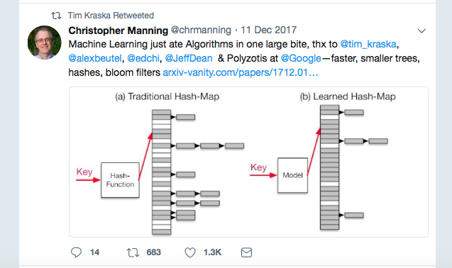
Why data management and ML?
Section 1 > Introduction
Boast

Slide 14
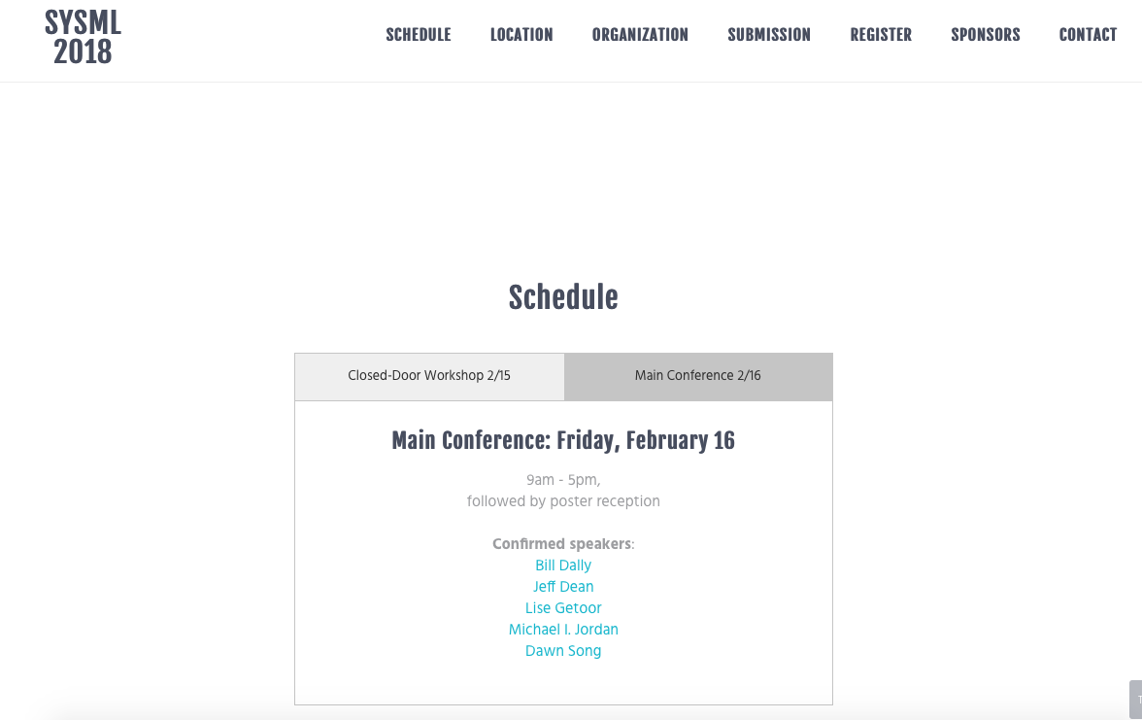
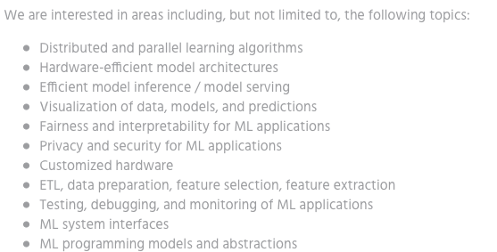
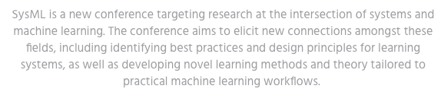
Why data management and ML?
Section 1 > Introduction
Intellectual:
Combine ideas from CS, statistics, optimization, etc.
The coolest new thing!
7 out of 11 are related to data management

Slide 15
What this course is (and is not)
Section 1 > Introduction
Discuss data management challenges at different stages of ML pipelines
How to find and manage multi-modal data to be consumed by ML pipelines.
How to prepare, enrich, and clean the data!
How to serve ML models fast!
Not how to be a Tensorflow ninja; not how to go into a Deep (learning) frenzy.
We’ll cover algorithms and systems for data preparation
And explore how to build DB-inspired ML systems

Slide 16
Who am I…
Section 1 > Administrative > Course Staff
Instructor (me) Theo Rekatsinas
Faculty in the Computer Sciences and part of the UW-Database Group
Research: data integration and cleaning, statistical analytics, and machine learning.
thodrek@cs.wisc.edu
Office hours: By appointment @CS 4361

Slide 17
Communication
Section 1 > Administrative
Piazza https://piazza.com/wisc/spring2018/cs839
Via email: thodrek@cs.wisc.edu
By appointment!
The goal is to be interactive! Both in class and online!

Slide 18
Course Website: https://thodrek.github.io/cs839-spring19/
Section 1 > Administrative

Slide 19
Course Google Drive: https://drive.google.com/drive/folders/1soJMN9FuuLOcC9diYtdSvfZZ9aZA4qBz?usp=sharing
Section 1 > Administrative

Slide 20
Lectures and Readings
Section 1 > Logistics
Lectures split into three parts:
Data exploration and understanding
Data preparation: Extraction, Integration, Cleaning
RBMS and ML integration
Each part covers multiple topics
Topics follow ML workload

Slide 21
Lectures and Readings
Section 1 > Logistics
Each class split in two parts:
First half: Lecture by me to cover basics
Second half: Discussion on papers led by you
At least two mandatory papers to read every week (subject to change)
More (optional) papers posted for every topic
How does this work: Questions, Comments, Responses (QCRs)

Slide 22
Questions, Comments, Responses
Section 1 > Logistics
For every class:
Each of you (apart from the discussion leaders) will post (at least three) Questions and Comments for the mandatory papers
The discussion leaders are responsible to summarize and answer/address these Questions and Comments
This can be either a presentation or a white-board talk by the leaders
After class the leaders are responsible to submit a written summary of our discussion
You need to read and understand the papers!

Slide 23
Responsibilities
Section 1 > Logistics
You need to form groups of three and sign up to lead discussions
Deadline is Friday 1/26
Same group for research project (more later) and paper discussions
We will use the class google repo for all QCRs (see Slide 19)
QCs need to be online a day before the class
Summary of Responses and discussion by leaders has to go after class

Slide 24
Graded Elements
Section 1 > Logistics
Questions and Comments (20%)
Response and Discussion (20%)
Research Project (60%)
Project proposal (10%)
Project intermediate report (10%)
Project final report (30%)
Project presentation and poster (10%
No exams or other hw

Slide 25
Research Project
Section 1 > Logistics
What can it be?
An open problem relevant to your research and the course
An open problem relevant to the course
Will post some suggestions later in the semester
Milestones
Part 1: Proposal (due ~week 2-3); feedback
Part 2: Intermediate report (due ~week 8-9); feedback
Part 3: Final presentations 4/26 and 5/1; Poster presentations 5/3
What is a good project?
Simple: it has to be publication worthy!

Slide 26
What is expected from you
Section 1 > Logistics
Attend lectures
If you don’t, it’s at your own peril
Be active and think critically
Ask questions, post comments
Do a publication worthy project
Start early and push hard

Slide 27
Lectures: 1st part – Data exploration
Section 1 > Lectures
What to expect form data: Visualizations, data cubes, feature-based analytics
Lectures 3,4
Leave no data behind: Data search and Data repositories
Lectures 5,6

Slide 28
Lectures: 2nd part – Data preparation
Section 1 > Lectures
3. Knowledge Base Construction (KBC)
Lectures 7, 9
Extraction as a statistical learning problem
Systems for KBC
Multimodal data
4. Data Integration
Lectures 10-12
Entity resolution: When two records refer to the same real-world entity?
Data fusion: How do we combine information from multiple sources
5. Data Wrangling and Cleaning; Management of Data under Uncertainty
Lectures 13-17
How to format semi-structured data?
How can we validate data: detect and fix errors
What about probabilistic data?

Slide 29
Lectures: 3rd part – RDBMS and ML Integration
Section 1 > Lectures
6. ML and Data Systems
Lectures 19-21
Relational vs Linear Algebra: It’s about semi-rings
SQL and UDFs, Scalable Inference Engines
7. DB-Inspired ML Systems:
Lectures 22,23
Execution plans and Rewrites
Compression and Indexing
8. ML serving:
Lectures 24,25
Feature engineering
Model hubs: the repositories of tomorrow

Slide 30
2. Data management challenges in ML pipelines
Section 2

Slide 31
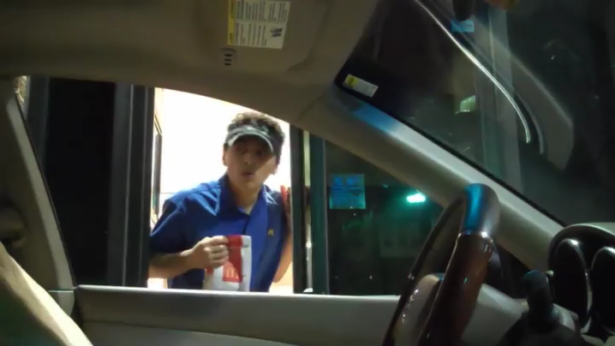
What is Machine Learning?
Section 2

Slide 32

Behind the scenes:
Section 2

Slide 33
Behind the scenes:
Section 2

Slide 34
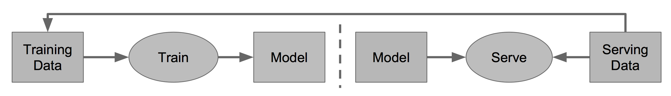
Behind the scenes (simpler):
Section 2

Slide 35
Where does data management show up?
Section 2
Having the right data is crucial for quality
Labels and features
Prepare the data for an ML pipeline: takes time (60% of time spent here)
We need data validation since errors cause problems

Slide 36
Starting point: Data and a question
Section 2
I have data!
I have a question!
Let’s use ML!
Input Data Characteristics
Sources: DBs, KV stores, Logs…
Formats: JSON, relational, unstructured
….
Raw or Curated
Invariants that describe data

Slide 37
Data-access is different in training/serving
Section 2
Training Input Data
Unit: aggregated data over multiple examples
Large size
High throughput: Train model fast
Testing Input Data
Unit: single or few examples
Small size
Low latency

Slide 38
Preparing the data
Section 2
Feature engineering
What features can be derived from the data?
Feature generation
How are these features generated in training and serving?
What are the properties of feature values?
How to transcode these features?

Slide 39
Example: Feature engineering
Section 2
Describe an apple
Picture size
RGB values
Edges
Surrounding text
…

Slide 40
Repeat!
Section 2
Things are still missing!

Slide 41
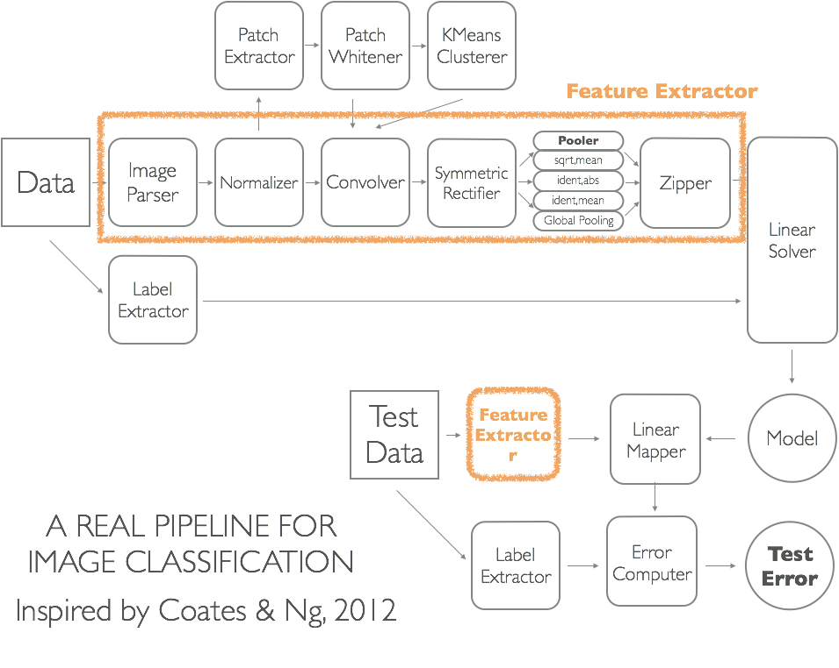
Section 2
Source: [talk by Shivaram Venkatamaran]

Slide 42
Everything here is fixed. Are we ready?
Section 2
What about errors during feature generation?
What about errors in new training examples?

Slide 43
Data failures are real
Section 2
Refactor backend that generates a feature
Imagine categorical features and now a new out of domain value
Hardware/sensor failures
The room temperature is 150F
Even worse:
Lanes?

Slide 44
Data failures are real
Section 2
Refactor backend that generates a feature
Imagine categorical features and now a new out of domain value
Hardware/sensor failures
The room temperature is 150F
Even worse: sometimes we cannot do anything but sometimes we can
What if we collect the new data to retrain the model?

Slide 45
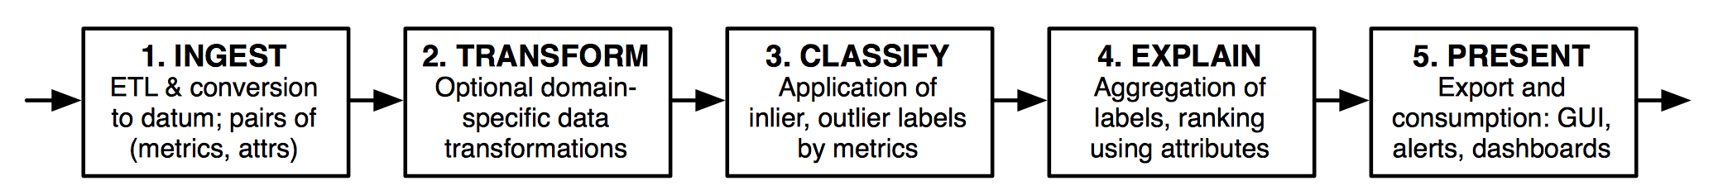
Data validation
Section 2
Monitoring
Ex.: outlier values
Alerts and error detection
How to formulate alerts so that are understandable and actionable?
Sensitivity for alerts?
Validation is itself a data management challenge
Source: [MacroBase]

Slide 46
Data Cleaning or Fixing your data
Section 2
Will fixing improve the downstream performance?
Which part of the data is problematic
What is the right repair?
How to backfill the data with the fix?

Slide 47
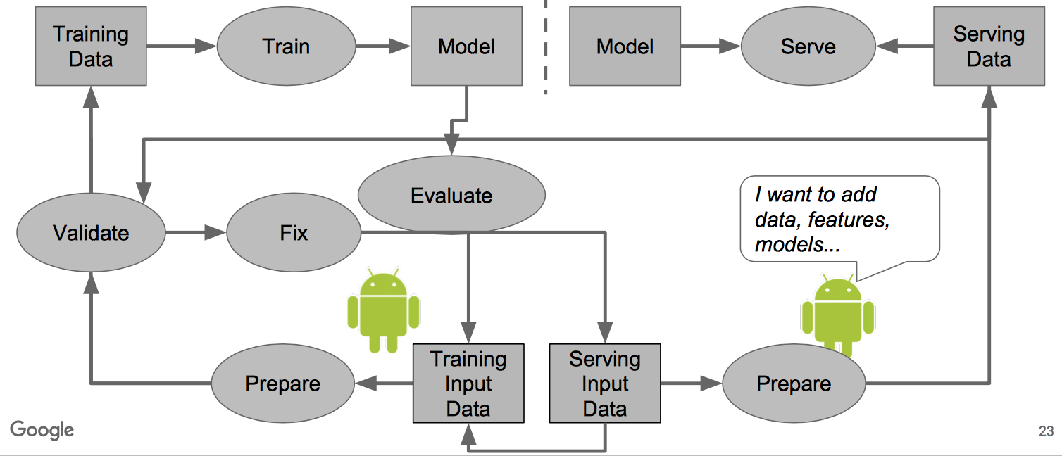
ML in Production
Section 2
Source: [Polyzotis et al., SIGMOD 2017]

